Slide 1
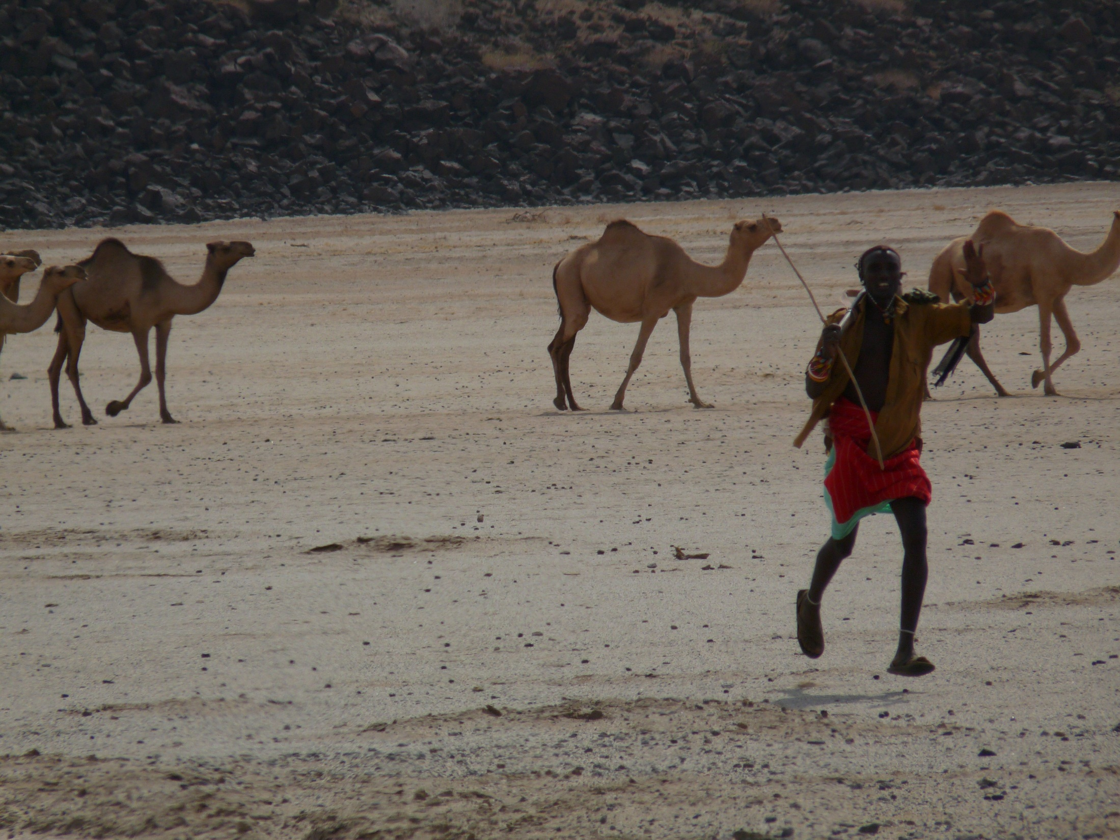

Escaping Poverty Traps and Sparking Structural Transformation in Low-Income Rural Areas
Chris Barrett, Cornell University
Virtual seminar to Renmin University
July 14, 2026

Slide 2

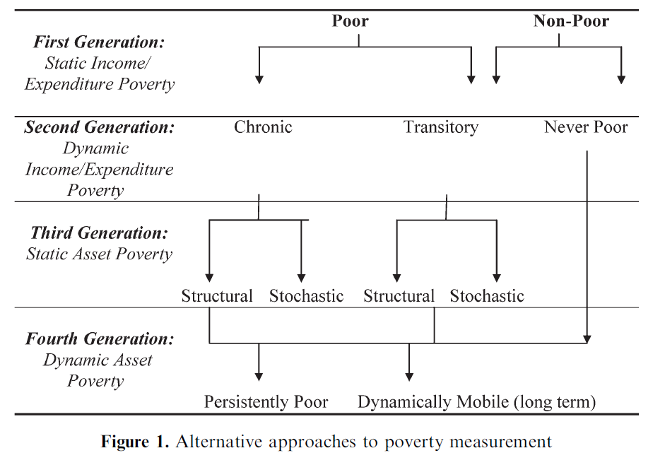
Conceptualizing poverty
How we think about/measure poverty matters for policy design.
Source: Carter & Barrett (2006 JDS)

Slide 3
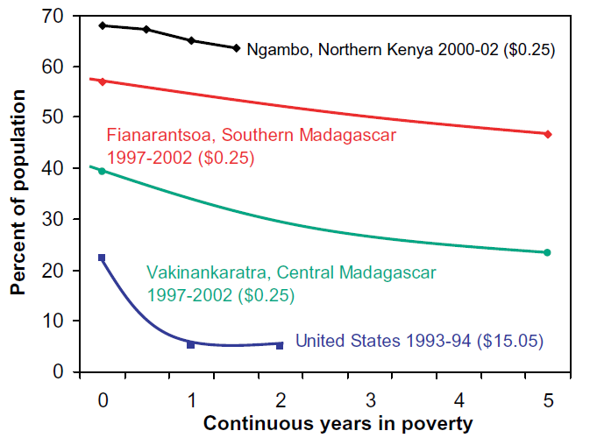
Deep, widespread, persistent poverty
The poorest places are defined not only by the depth and prevalence of poverty but equally by poverty’s persistence. Indeed, we lack data to estimate poverty’s half-life in most poor places.
Source: Barrett & Swallow (2006 WD)

Slide 4
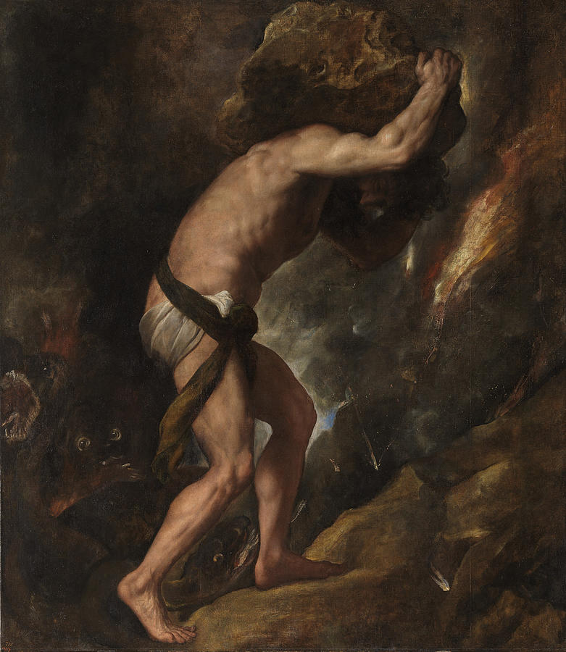


Why deep, widespread, persistent poverty?
A long, contentious literature on poverty traps. Focus on deterministic, non-ergodic systems – e.g., nutritional poverty traps: a Sisyphean struggle in which people are doomed.
(Titian, Sisyphus, 1549)
But people can escape against formidable odds … generates feel-good stories we celebrate.
Poverty traps concerns risk and nonstationarity more than ergodicity!

Slide 5
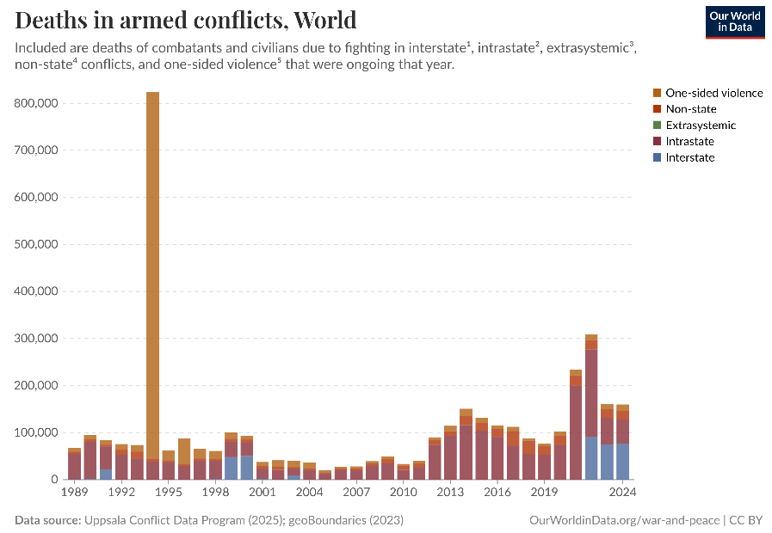
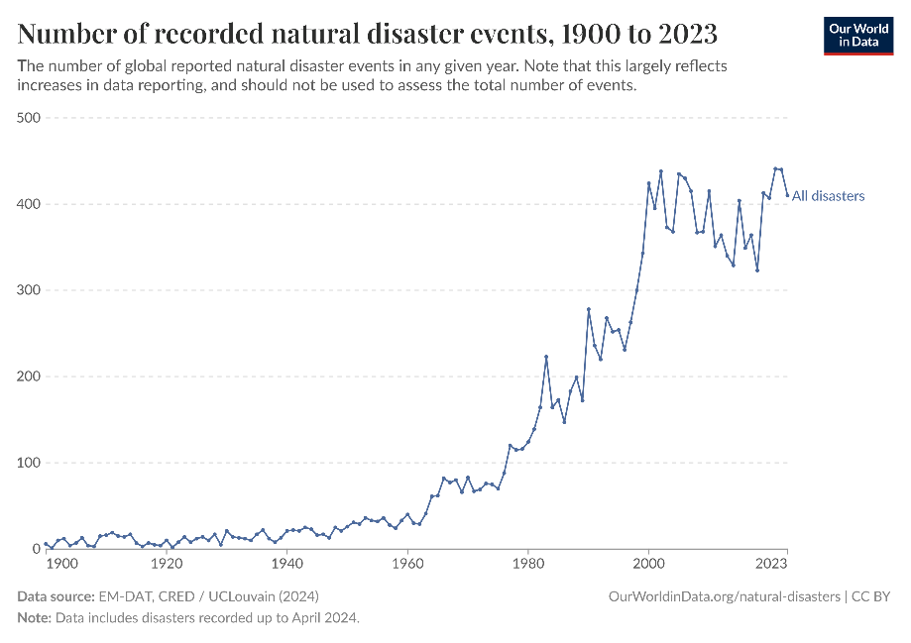
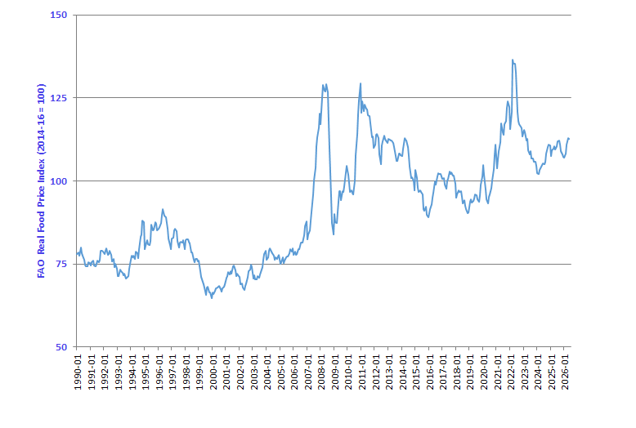

Matters in a world growing riskier
The world – and especially low-income, rural communities – face increasing risk of climate/conflict/food price/other shocks.

Slide 6
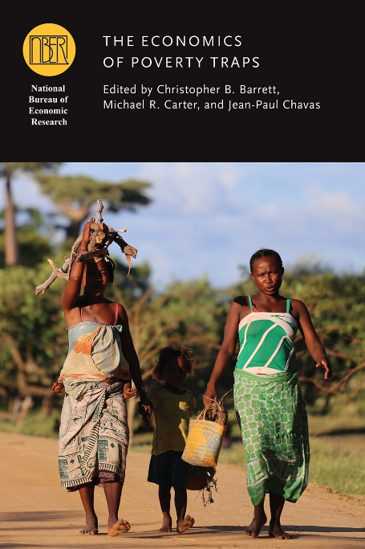
Risk-based poverty traps
Poverty traps arise where peoples’ optimal behaviors both reinforce and are limited by their current poverty.
Poverty and uninsured risk exposure highly correlated. So maybe risk exposure is the key factor to address?
The possibility of risk-based poverty traps puts a premium on risk reduction and risk transfer tools: credit, insurance, savings, novel technologies, social solidarity networks, etc. May help explain the limited long-term gains of cash transfers programs.

Slide 7
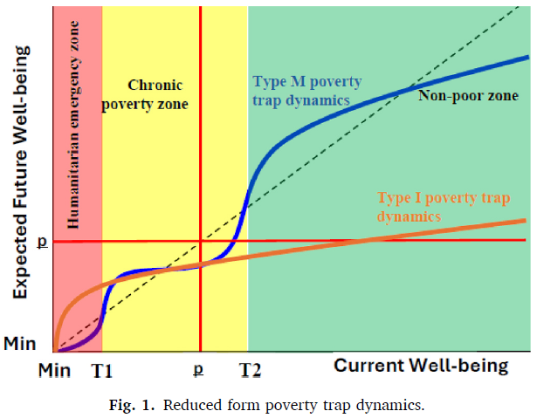

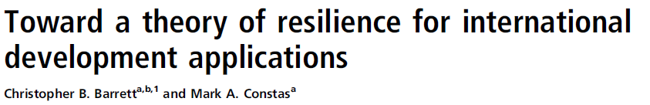
Risk-based poverty traps
A population is a mixture distribution of well-being dynamics. The poor sub population is a mixture distribution of the inescapably (Type I) and the unnecessarily poor who face multiple equilibria (Type M). Risk is salient for all, especially the latter subpopulation.

Slide 8
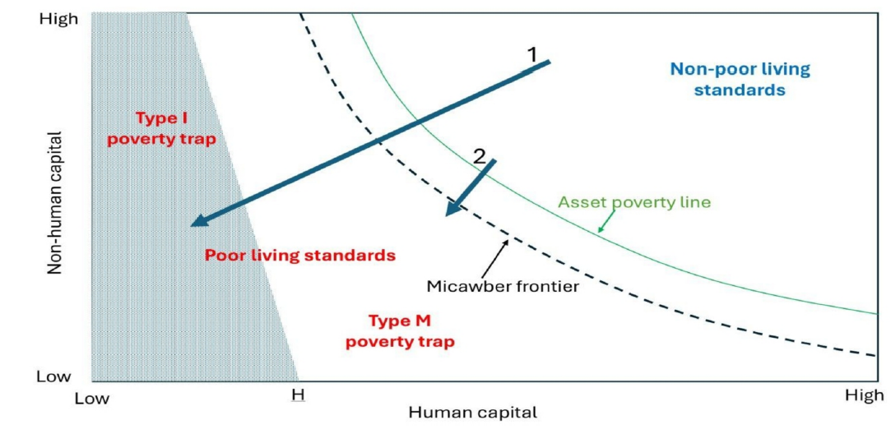
Risk-based poverty traps
Various mechanisms underpin poverty traps: (1) market imperfections, esp. in financial and land markets, due both to the impact of shocks and ex ante risk response; (2) behavioral phenomena, related to cognition, mental health, social solidarity, etc.

Slide 9
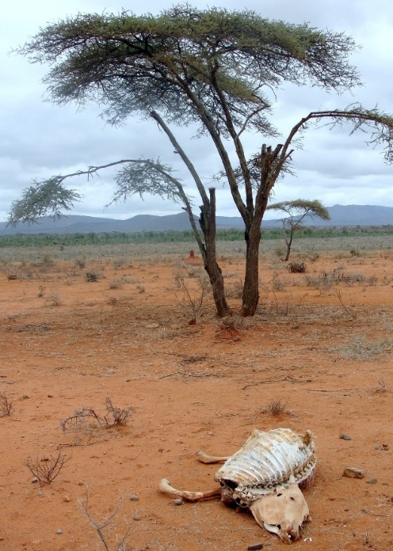
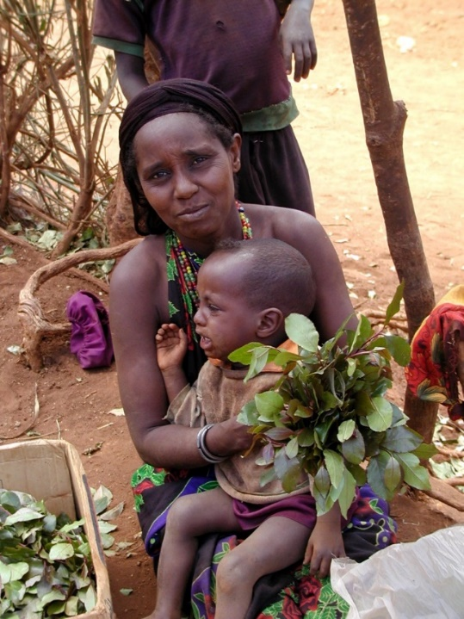
Example 2: Index-based livestock insurance (IBLI)
Ex 1: Drought risk and poverty traps among east African pastoralists
Poverty traps exist in the arid and semi-arid lands of Kenya/Ethiopia. Catastrophic herd loss risk due to major droughts is the major cause of these dynamics. Puts a premium on drought risk management, both for individuals and for society.
Sources: Lybbert et al. (2004 EJ) and Santos & Barrett (2011 JDE, 2019 UCP/NBER volume) on Boran in s. Ethiopia. Barrett et al. (2006 JDS) and Chantarat et al. (2017 WD) in n. Kenya.

Slide 10
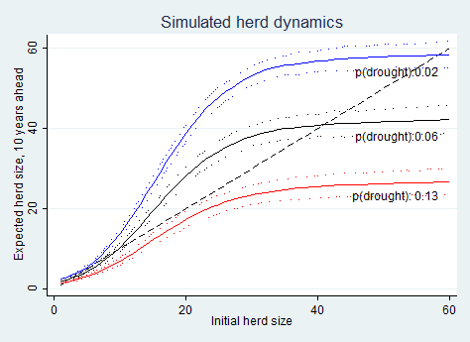
Ex 1: Drought risk and poverty traps among east African pastoralists
Pastoralist systems are well-adapted to weather shocks. But is it resilient to a shift in climate? Many models predict increased rainfall variability (i.e., increased risk of drought). Climate change has perhaps caused the poverty trap?
Herd dynamics differ b/n good and poor rainfall states, so change w/drought (<250 mm/yr) risk.
In southern Ethiopia, in expectation, doubling drought risk leads to system collapse in the absence of any change to prevailing herd dynamics.
Source: Barrett and Santos (Ecol Econ 2014)

Slide 11
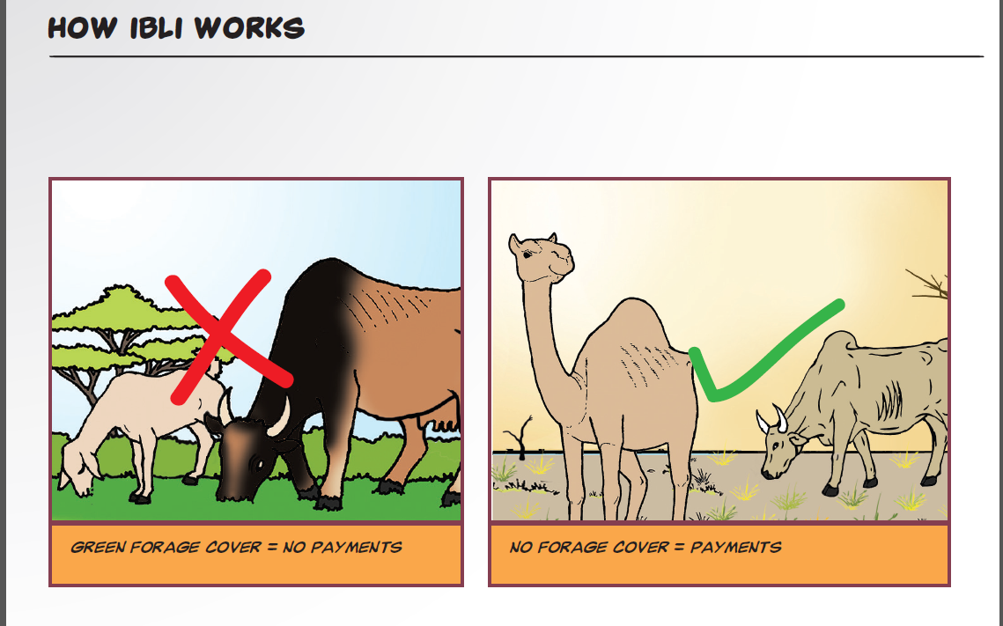
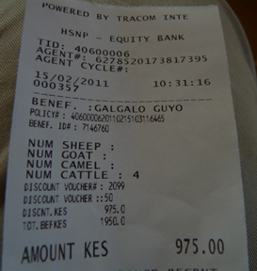
Ex 1: Drought risk and poverty traps among east African pastoralists
So we designed and launched index-based livestock insurance (IBLI) in 2010. Used RS NDVI series to price risk. Leverage reinsurance industry to transfer African drought risk into global capital markets.
Index of expected herd loss based on historical NDVI-mortality relationship. For expected losses >15%, seasonal payment from reinsured local insurance company.

Slide 12
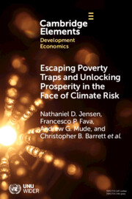
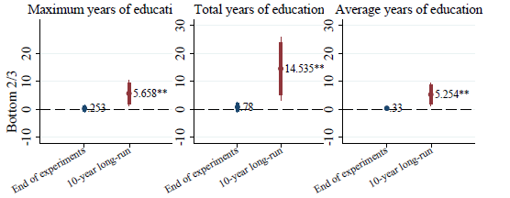
(Jensen, Barrett &2014)
Ex 1: Drought risk and poverty traps among east African pastoralists
IBLI is an imperfect product. Removes only ~35% of loss risk. Yet worked as designed, with big impacts. Marginal impact on income, productivity, MUAC, etc. is 6-45x that of cash transfers!
10-year impacts show bifurcated impacts, with biggest gains in children’s education among households w/smallest 2/3 of baseline herd size.
Now covers >5 million pastoralists plus government sovereign drought risk across 5 countries (w/2 more pending).

Slide 13
Ex 2: Infectious disease risk reduction in west Africa
Schistosomiasis/bilharzia affects >240mn globally (>800 mn at risk) in poor areas. Suppresses immunoresponse. Disrupts work/school attendance. Suppresses immunoresponse. Especially harmful for children/women.
Usual response: MDA (praziquantel) but high reinfection rates. Must tackle the environmental reservoir of the disease.
Poverty-disease trap: Impedes child cognitive/physical dev’t via anemia, morbidity. Disrupts work/school attendance, lowers incomes, increasing reliance on contaminated water sources.

Slide 14
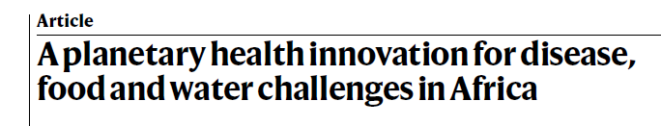
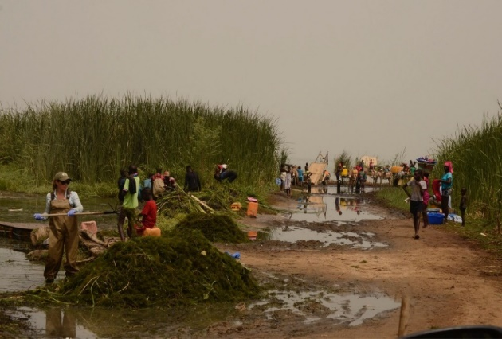
Ex 2: Infectious disease risk reduction in west Africa
Multi-pronged approach:
Method 1: Clear water access points of snails’ preferred habitat, the invasive, submerged weed Ceratophyllum demersum.
Researcher-managed trials work very well. Sharp reduction in child reinfection rates.
Can use to make compost (B/C:
2.8 - 7.1) or livestock feed.
2024 Frontiers Plant Prize global champion!

Slide 15
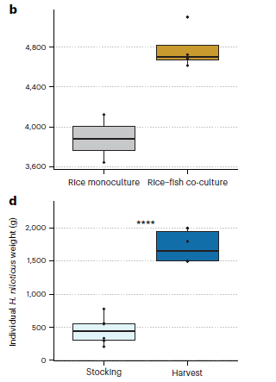
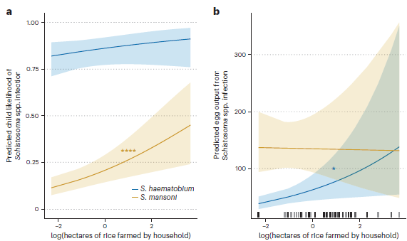
Ex 2: Infectious disease risk reduction in west Africa
Method 2:
Schisto infection prevalence and intensity positively assoc. w/rice cultivated area.
Introduce fish to irrigated rice fields to compete with (tilapia) or prey on (African bonytongue) snails and boost crop and fish productivity. Win-win-win.

Slide 16
Ex 2: Infectious disease risk reduction in west Africa
Method 3:
Livestock suffer from schisto and serve as an environmental reservoir that can reinfect cleared surface water and irrigated rice plots. Plus, Schistosomiasis bovis hybridizing w/human forms!
So about to start stage 3 livestock vaccine trials.
Aim to establish (i) livestock productivity, fecundity gains, (ii) reductions in human schisto, and (iii) possible reductions in enteric methane emissions.
More in a year or soon (we hope/expect) …

Slide 17
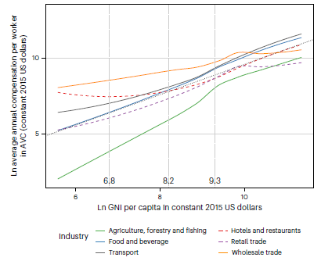
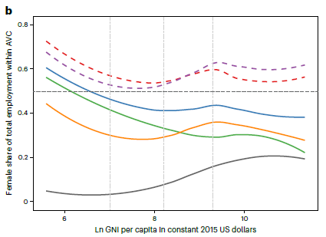
Food value chain employment dynamics
As incomes rise, consumer demand growth concentrates primarily in post-harvest value added. Jobs migrate downstream from ag. This leads to rising average earnings (but increased gender earnings inequality). Requires education/health. Greater exposure to macro shocks (e.g., COVID).

Slide 18
Facilitating escape from poverty traps
Rural populations disproportionately suffer widespread, deep, persistent poverty. Also face considerable uninsured risk exposure. Solving the poverty problem requires addressing the risk issue.
Solutions include risk reduction (e.g., vaccines) and risk transfer (e.g., insurance) while boosting productivity and facilitating transition from intrinsically-risky agriculture to higher-return, post-farmgate jobs. Human capital investments and macro stability essential.

Slide 19
Thank you for your time, interest and comments!
Links to my papers at
https://barrett.dyson.cornell.edu/
Or email me at chris.barrett@cornell.edu
Notes:
19

